Slide 1
The Secret Code of Filming

Slide 2
The Secret Code of Filming Mise en scène
Contrasts
Character Placements
Elements of Set Composition
Theory of organic form: form and content are mutually dependent in any art form.
To review:
Mise en scène (pronounced meez on sen) was originally a French theatrical term meaning “placing on the stage.”
In film, it refers to how the filmmaker arranges the objects and people within the frame of the shot.

Slide 3
Contrasts
The human eye automatically attempts to unify various elements within a composition. In most cases, the eye sees the items individually before seeing the whole picture.
The area of an image that most immediately attracts our attention is the dominant contrast, or the dominant. This effect can be achieved through color, spacing, size, movement, and lighting effects.
After we take in the dominant, our eye scans the subsidiary contrasts that the artist has arrange as counter balancing devices.
Schindler’s List

Slide 4
Character Placement
Framing: The areas of the frame affect the significance of the subject
The area near the top of the frame can suggest ideas dealing with power, authority, and aspiration. A positive character placed there could seem in control of his/her situation, while a negative character placed there could seem threatening.
The areas near the bottom of the frame tend to suggest subservience, vulnerability, and powerlessness.
The areas to the left and right edges of the frame suggest insignificance, because they are farthest removed from the center.

Slide 5
Character Placement
From the movie Gattaca, Irene is in a position of power over Vincent here, as she can decide to either accept or reject him.

Slide 6
Character Placement
Proxemics: The distance between the camera and the subjects affects the significance of the subject
The closer we are to a character, generally speaking, the more emotionally involved we become.
Proxemic patterns refer to the relationships of organisms within a given space.
The greater the distance between the camera and the subject the more emotionally neutral we remain to them.
The proxemic distances correspond roughly to the shots.

Slide 7
Intimate Distance
Gattaca
Skin contact to about 18 inches away
This can reflect love, comfort, or tenderness, or suspicion, hostility, and fear, depending on the viewer’s relation to the subject
This corresponds to the close-up and the extreme close-up

Slide 8
Personal Distance
To All the Boys I’ve Loved Before
18 inches to 4 feet away
These distances tend to be reserved for family and friends, yet do not exclude outsiders as intimate distances do.
The medium shot captures this distance

Slide 9
The Social Distance
To All the Boys I’ve Loved Before
4 feet to 12 feet away
These are distances reserved for impersonal business and casual gatherings.
Full shot ranges corresponds to this distance

Slide 10
Public Distance
12 feet to 25+ feet away
This range suggests detachment and a lack of emotional involvement.
The long shot and the extreme long shot correspond to this distance

Slide 11
To All the Boys I’ve Loved Before
What do you notice about the framing of this scene?
What does it tell us about the two characters?

Slide 12
Elements of Set Composition
As most films use created sets, everything in those environments is artificially assembled. It is all purposely placed to provide and contribute to the context of the action and to help the director communicate the film’s theme.
Film Noir is often abounding with visual metaphors of entrapment, such as alleys, tunnels, train cars, etc.
The tone is fatalistic and paranoid, suffused with pessimism, emphasizing the darker aspects of the human condition.
Its subjects characteristically involve violence, lust, greed, betrayal, and depravity.

Slide 13
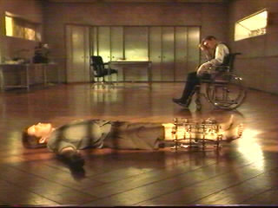
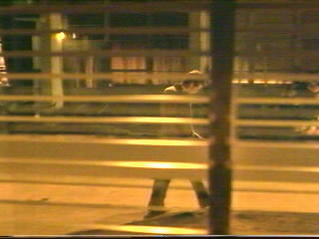
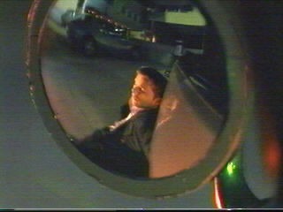
Elements of Set Composition in Gattaca
The costuming, color, and props all give the feel of an example of 1940s Film Noir.
Images of characters entrapped, virtually imprisoned, abound.
These are all images of entrapment with shadows acting as prison bars, cutting the characters off from the world. Even the mirror reflection of Vincent minimizes him in the frame, containing him and separating him from freedom.

Slide 14
Film Noir
Literally “black films,” as termed by the French cinema critical establishment.
Film Nor is a genre of film that flourished in America from 1941-58
Focus on urban crime and corruption and on sudden up-swellings of violence in a culture whose fabric seems to be unraveling
Because of these concerns, film noir seems to be largely about violations:
Vice
Corruption
Unrestrained desire
The abrogation of the American Dream’s promise of hope, prosperity, and safety from persecution.

Slide 15
Film Noir Components
Characters who are motivated by selfishness, greed, cruelty, and ambition and who are willing to lie, frame, double-cross, and kill or have killed
Often fatalistic and have characters doomed to fail
Frequent dark scenes, many at night
Low key (dark, shadowy) lighting
Shots obscured by objects, like venetian blinds
Urban settings

Slide 16
Examples and Impact of Film Noir

